Slide 1

Hotel Management System
Team members
Ritvij Naram - 002663839
Imran Khan Pathan - 002081941
Durga Dhana Sree Chilukuri - 002481050
Amir Pourvahaby - 002416506

Slide 2
Table Of Content
The Problem.
What We Tried To Do.
How it Turned Out.
Use Case diagram.
Use Case Scenario
Class diagram.
Learnings.

Slide 3
Problems in Earlier Hotel Management
Manual Updates
Limited Features
Complicated Interfaces
No Cloud-Based Solution
Limited Accessibility

Slide 4
What We Did to Overcome These Problems
Java Swing and MySQL Integration
Cloud-Based Features
Enhanced Functionalities
User-Friendly Interface
Modern Tools

Slide 5

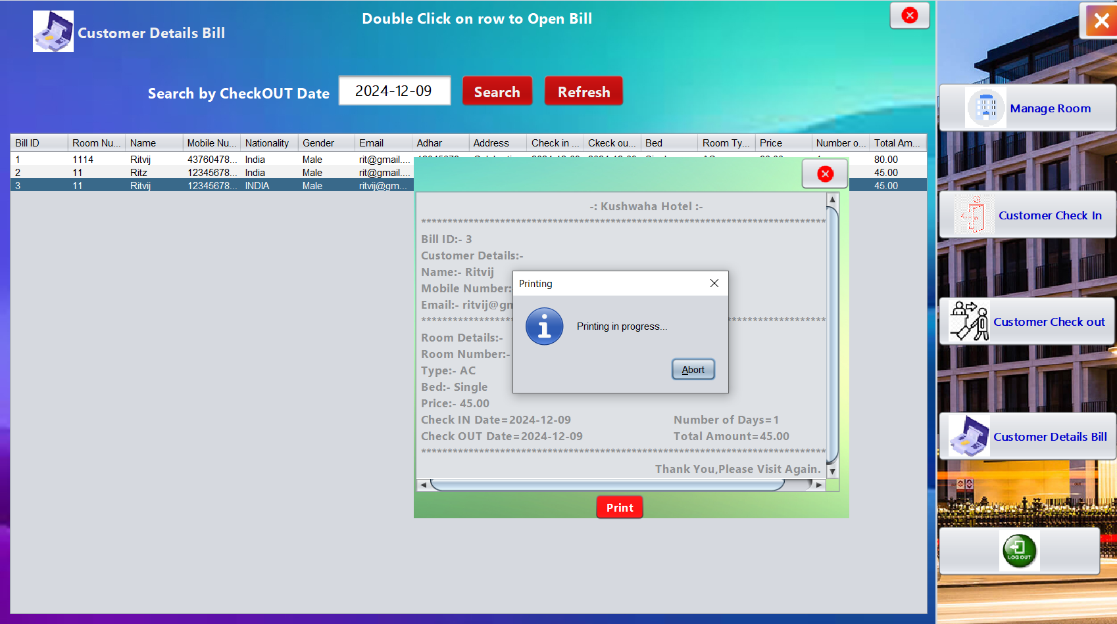
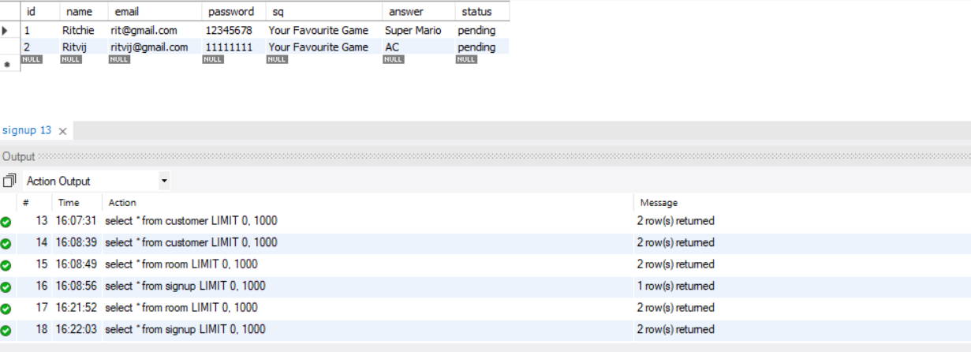
How it Turned Out

Slide 6
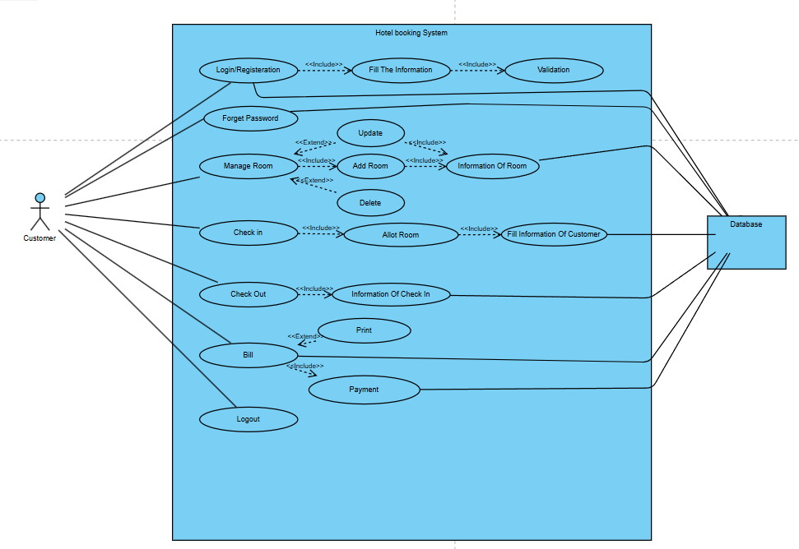

Use Case Diagram

Slide 7
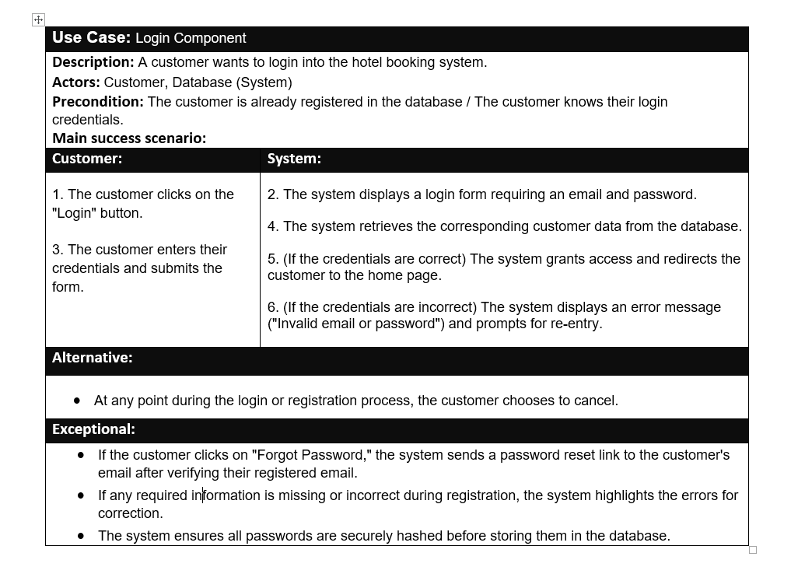

Slide 8
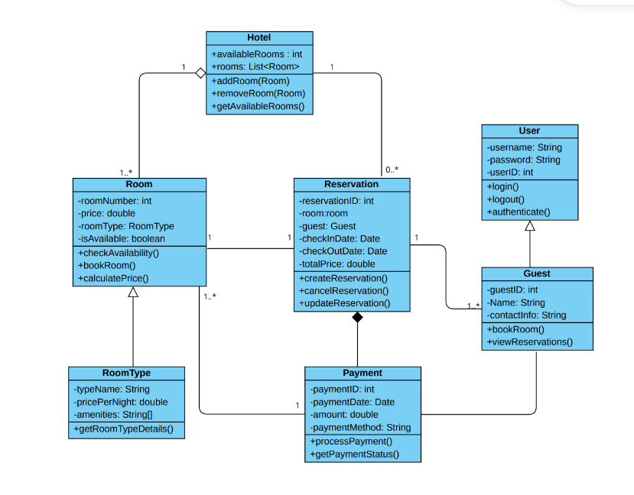
Class Diagram

Slide 9
Learnings
Requirement gathering
Application testing
Implementation using Java swing and mySQL

Slide 10

Moving on to the Demo

